Slide 1

Changepoint Submission
The idea is to do a regular change point submission on friday @4.45pm , to modulate this work flow using agents is the tasks that i took.

Slide 2


Workflow: Daily Scrum & Changepoint Logging
Step 1: Open the Confluence Scrum Page
→ Navigate to the Confluence page for the current date.
Step 2: Find Your Name Under the Daily Scrum Notes
→ Locate my section under today’s date.
Step 3: Copy my Scrum Notes
→ Copy the update written (if available) or note “OOO” if applicable.
Step 4: Elaborate/Refine my Update
→ Add a few words to make the message clearer or more descriptive.
Step 5: Log Into Changepoint
→ Open my assigned project/task bucket for the day.
Step 6: Paste the Update & Select Category
→ Paste the refined update and assign it to the right task or category (e.g., task, holiday, support).
Step 7: Submit/Save the Entry
→ Submit my entry for the day in Changepoint.

Slide 3
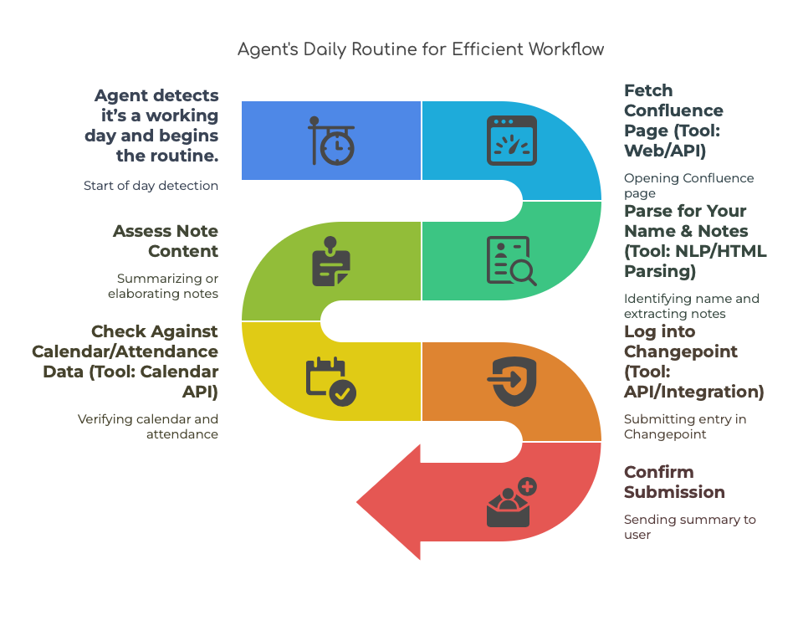
Agent Flow

Slide 4
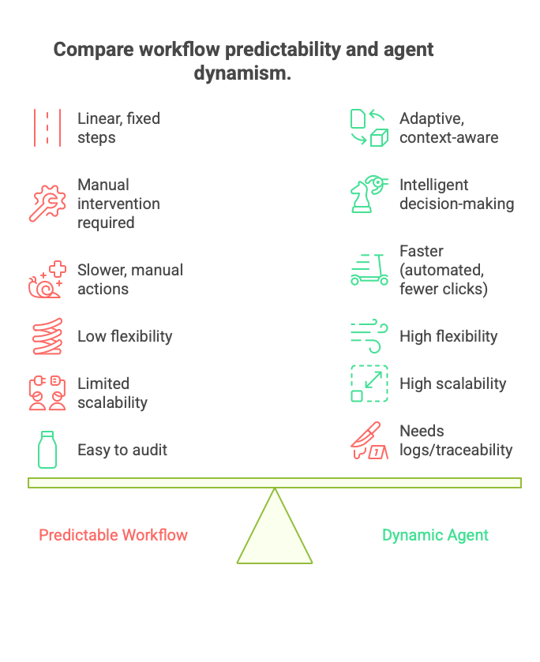
Comparison b/w Agent and Workflow

